Slide 1
Driverless Technology
BUS237
Javier Taylor; Xinhe Yu; Yang Xu; Helena Zhao

Slide 2
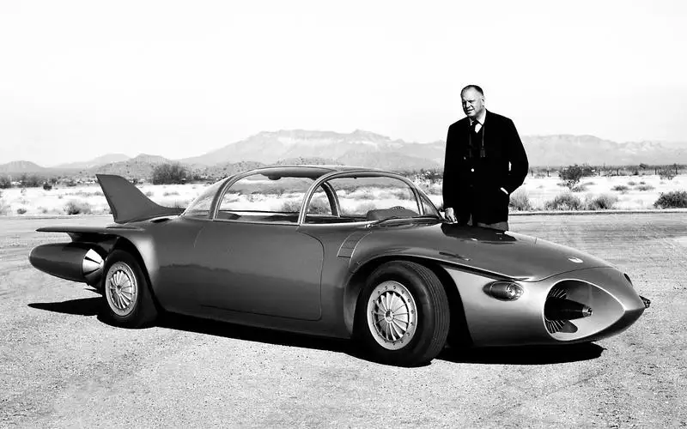
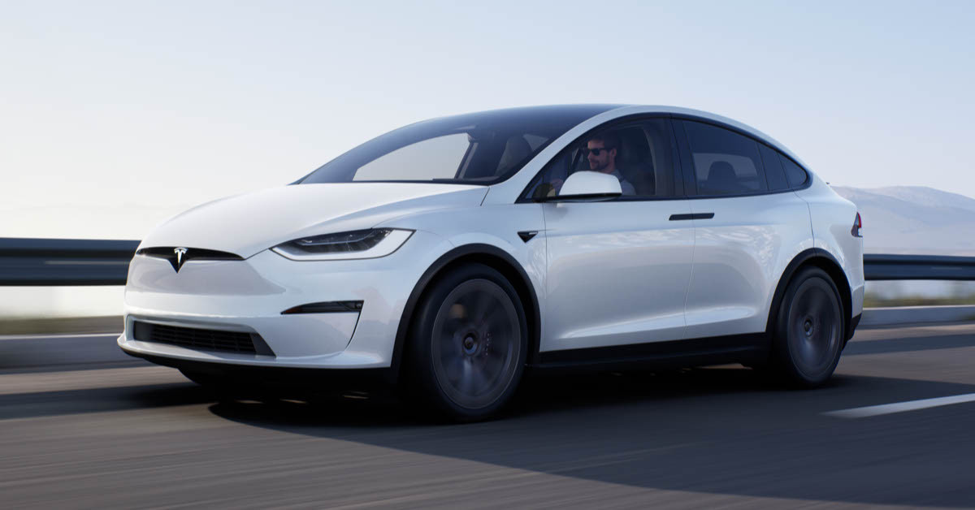
What is Driverless Technology?
A vehicle that is capable of sensing its environment and moving safely with little or no human input.

Slide 3

How does it work?
LIDAR (Light Detection and Ranging) Scanning

Slide 4

How does it work?
LIDAR (Light Detection and Ranging) Scanning
Radar (Radio Detection and Ranging) Scanning

Slide 5


How does it work?
LIDAR (Light Detection and Ranging) Scanning
Radar (Radio Detection and Ranging) Scanning
Camera
GPS (Global Positioning System)

Slide 6
How does it work?
LIDAR (Light Detection and Ranging) Scanning
Radar (Radio Detection and Ranging) Scanning
Camera
GPS (Global Positioning System)

Slide 7
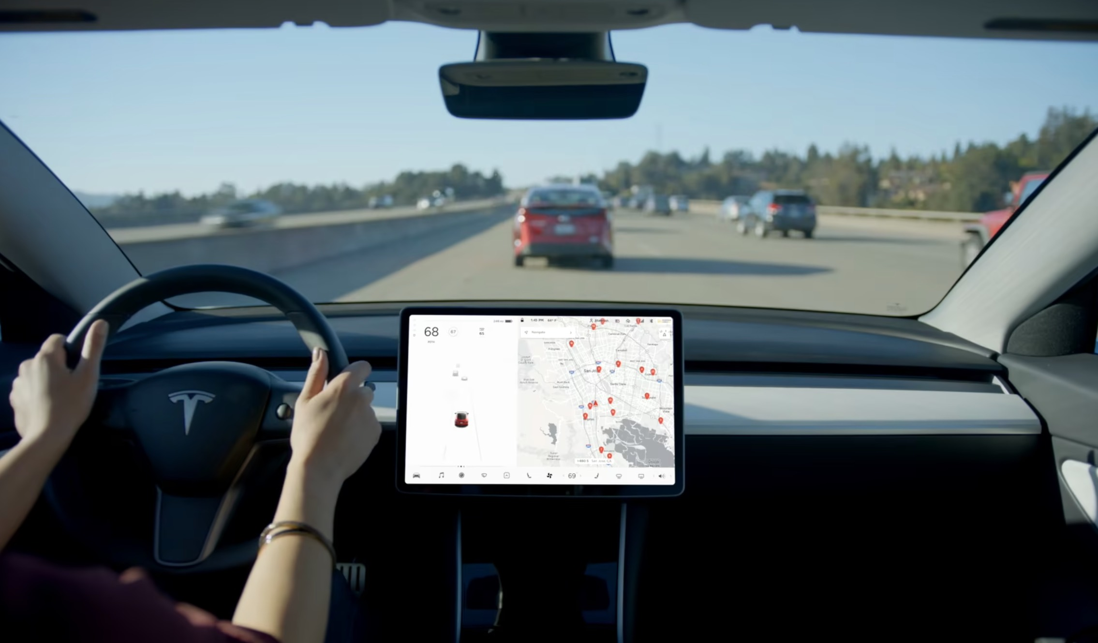
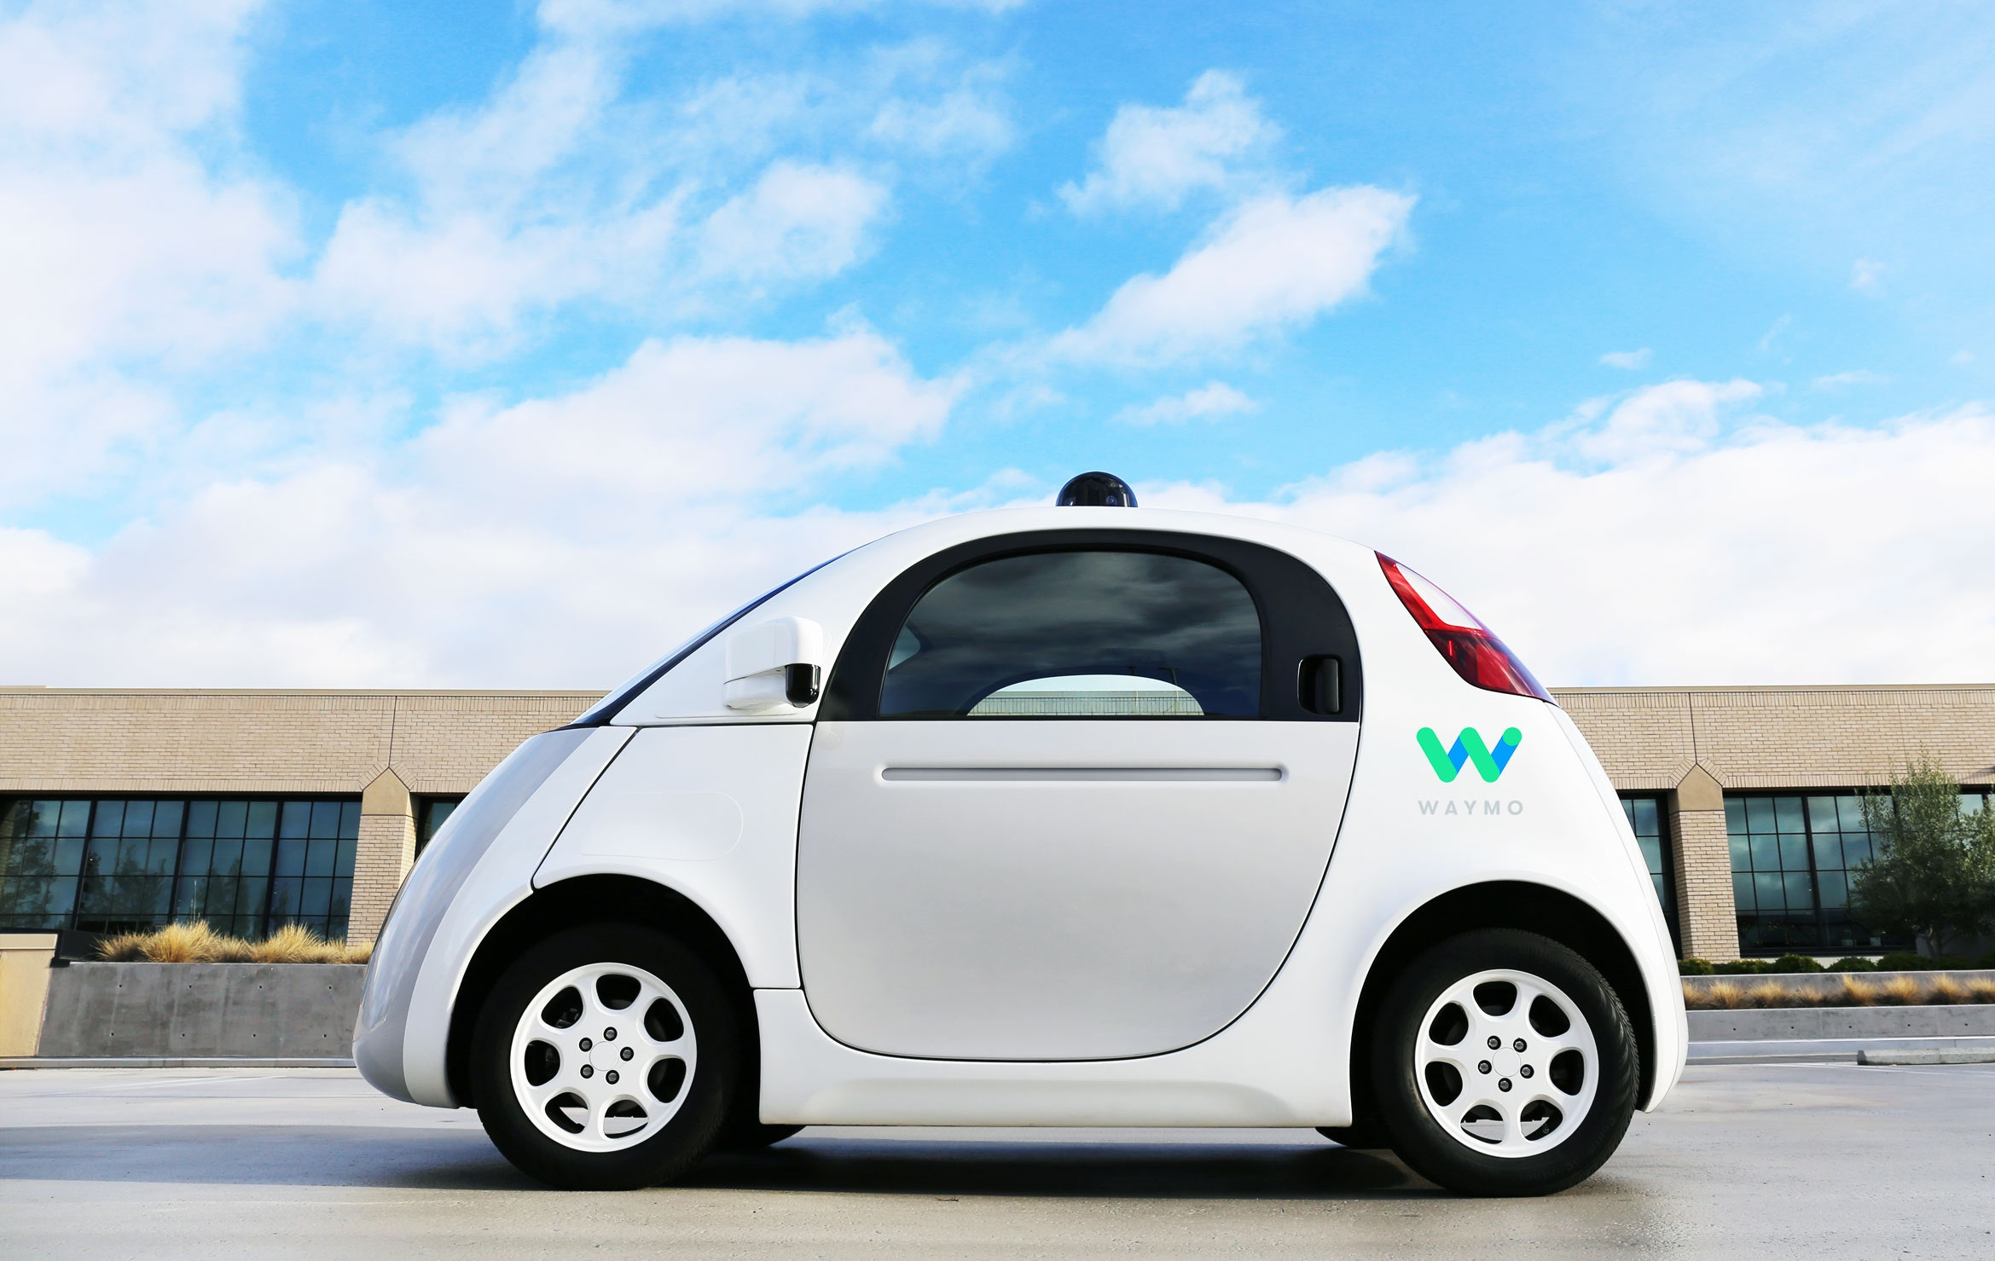
Driverless Company
Tesla
Waymo
Radar & Ultrasonic sensors
Radar-laser technology & Maps
(Hoffman, 2021)
(Grendelkhan, 2017)

Slide 8
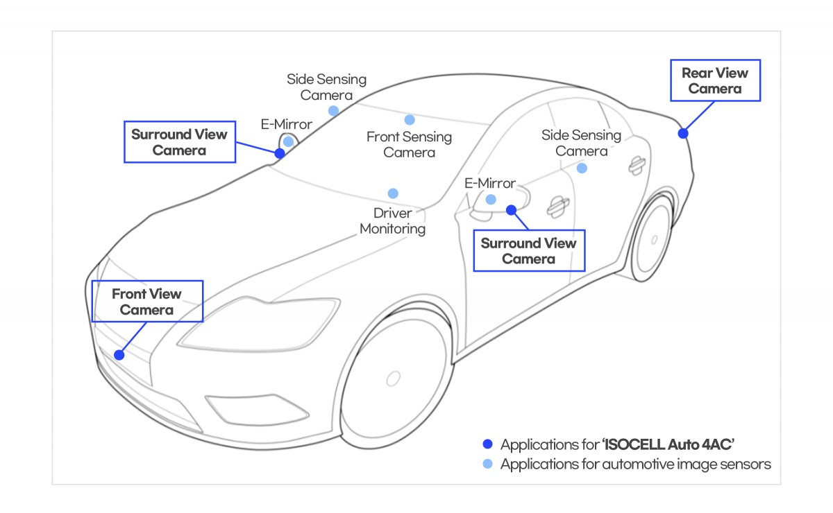

Slide 9
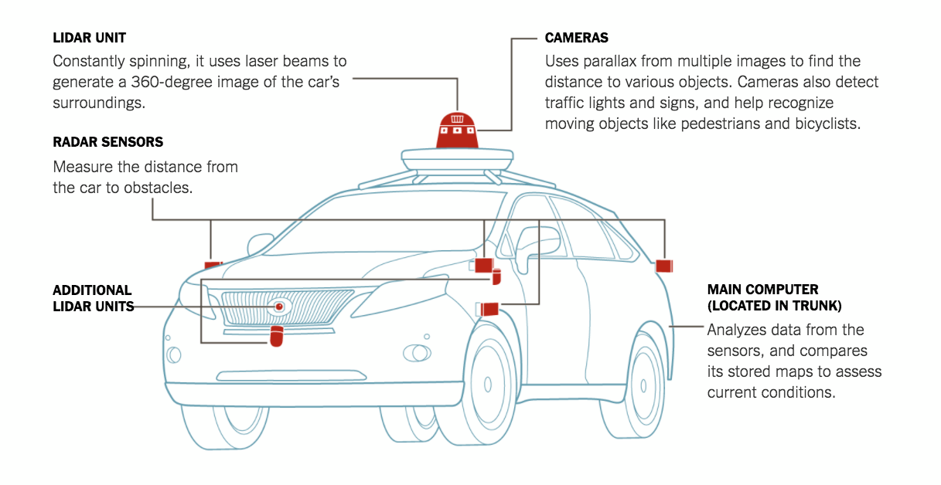

Slide 10

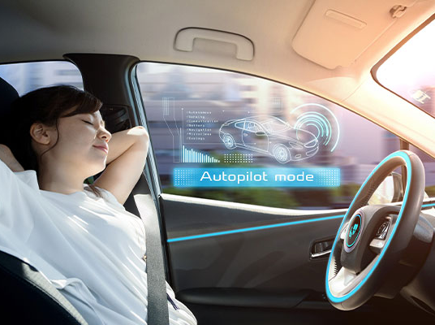
Advantages
01
02
Fewer Accidents
Recapturing Time
03
04
Reduced Driver Stress
Increased mobility for non-drivers
05
06
Reduced need for car ownership
Fuel cost savings

Slide 11

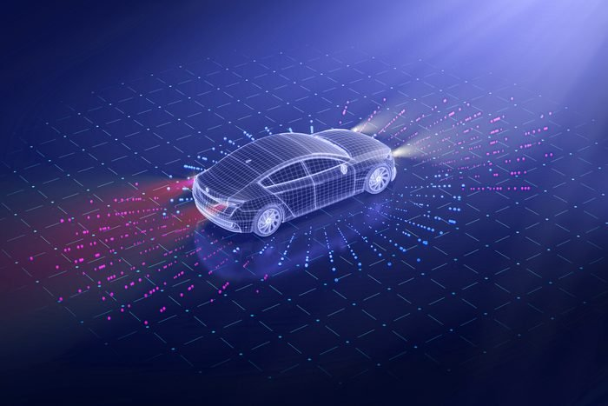
Disadvantages
01
02
03
Cost
Safety and Security Concerns
Prone to
hacking
04
05
Non-functional Sensors
Fewer Job Opportunities

Slide 12

How can this help Business Managers?

Slide 13
LEVELS OF AUTONOMOUS VEHICLES
Level 0
Level 1
Level 2
Level 3
Level 4
Level 5
No automation
Humans have full control of systems
1+ driving technology
Ex. Honda civic with adaptive cruise control
2+ driving technology
Ex. 2018 Tesla Model S
Limited automation under certain conditions
Ex. 2019 Audi A8
Full automation in most conditions
Ex. Hyudai’s NEXO
Full automation in all conditions
Non existent

Slide 14
LEVELS OF AUTONOMOUS VEHICLES
Level 0
Level 1
Level 2
Level 3
Level 4
Level 5
No automation
Humans have full control of systems
1+ driving technology
Ex. Honda civic with adaptive cruise control
2+ driving technology
Ex. 2018 Tesla Model S
Limited automation under certain conditions
Ex. 2019 Audi A8
Full automation in most conditions
Ex. Hyudai’s NEXO
Full automation in all conditions
Non existent

Slide 15
LEVELS OF AUTONOMOUS VEHICLES
Level 0
Level 1
Level 2
Level 3
Level 4
Level 5
No automation
Humans have full control of systems
1+ driving technology
Ex. Honda civic with adaptive cruise control
2+ driving technology
Ex. 2018 Tesla Model S
Limited automation under certain conditions
Ex. 2019 Audi A8
Full automation in most conditions
Ex. Hyudai’s NEXO
Full automation in all conditions
Non existent

Slide 16
LEVELS OF AUTONOMOUS VEHICLES
Level 0
Level 1
Level 2
Level 3
Level 4
Level 5
No automation
Humans have full control of systems
1+ driving technology
Ex. Honda civic with adaptive cruise control
2+ driving technology
Ex. 2018 Tesla Model S
Limited automation under certain conditions
Ex. 2019 Audi A8
Full automation in most conditions
Ex. Hyudai’s NEXO
Full automation in all conditions
Non existent

Slide 17
LEVELS OF AUTONOMOUS VEHICLES
Level 0
Level 1
Level 2
Level 3
Level 4
Level 5
No automation
Humans have full control of systems
1+ driving technology
Ex. Honda civic with adaptive cruise control
2+ driving technology
Ex. 2018 Tesla Model S
Limited automation under certain conditions
Ex. 2019 Audi A8
Full automation in most conditions
Ex. Hyudai’s NEXO
Full automation in all conditions
Non existent

Slide 18
LEVELS OF AUTONOMOUS VEHICLES
Level 0
Level 1
Level 2
Level 3
Level 4
Level 5
No automation
Humans have full control of systems
1+ driving technology
Ex. Honda civic with adaptive cruise control
2+ driving technology
Ex. 2018 Tesla Model S
Limited automation under certain conditions
Ex. 2019 Audi A8
Full automation in most conditions
Ex. Hyudai’s NEXO
Full automation in all conditions
Non existent

Slide 19
What is the future for self-driving cars?
Fully automatic under
any condition
Reliable Software
Predict the
unpredictable
Maintain relationship with
pedestrians and other vehicles

Slide 20
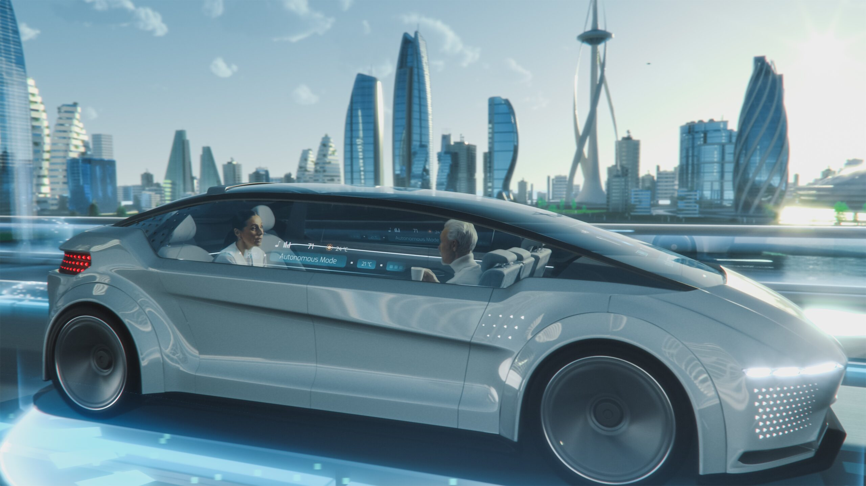
It might not happen tomorrow, next week or even a year from now, however, we can definitely expect to see Fully Automated Driverless Technology in the future!

