Slide 1
Tesla's AI robot Optimus
- By Xinhe Yu Arianna

Slide 2
Main point in article
Cost less than a car
Future with no poverty

Slide 3
Analysis and critique
Operating post
Competitiveness of Tesla's AI robots
Concerns for the future

Slide 4
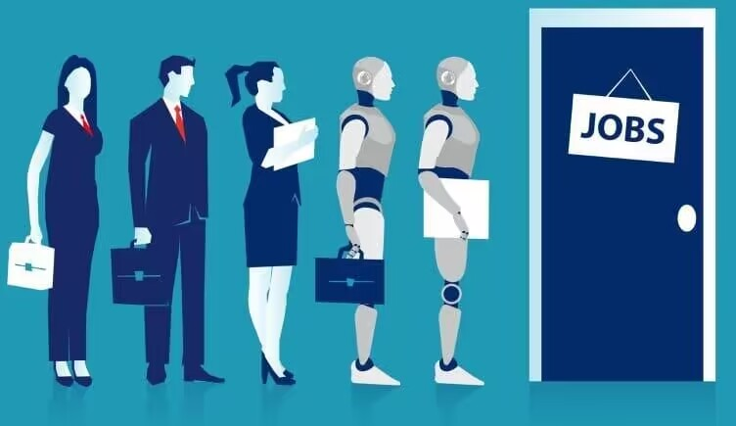
Artificial Intelligence’s Impact on the Future of Jobs
2025
- replace 85 million jobs worldwide
- create 97 million new jobs
Workers Don’t Have The Skills Required
- robotics and software engineering

Slide 5
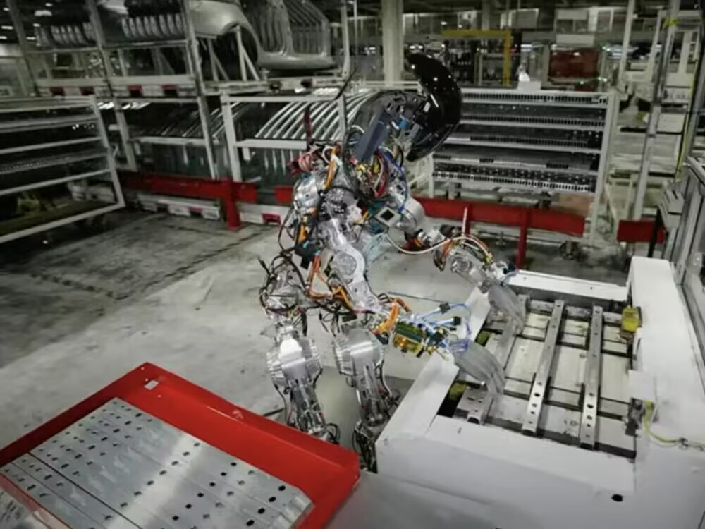
Competitiveness of Tesla's AI robots
Optimus

Slide 6
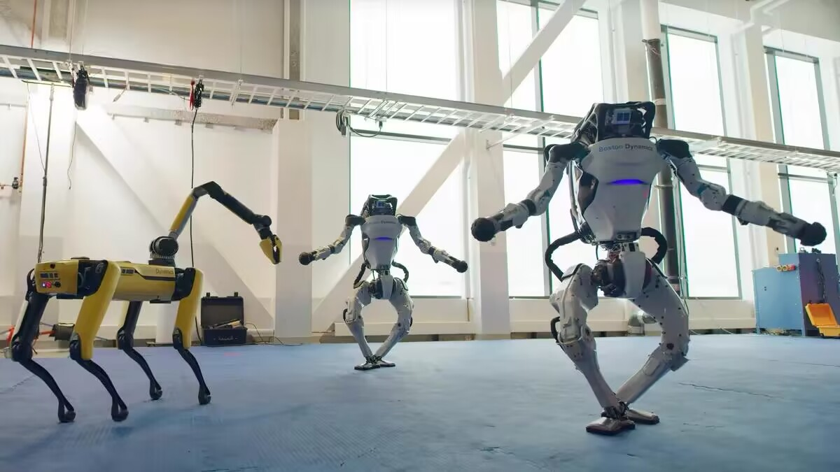
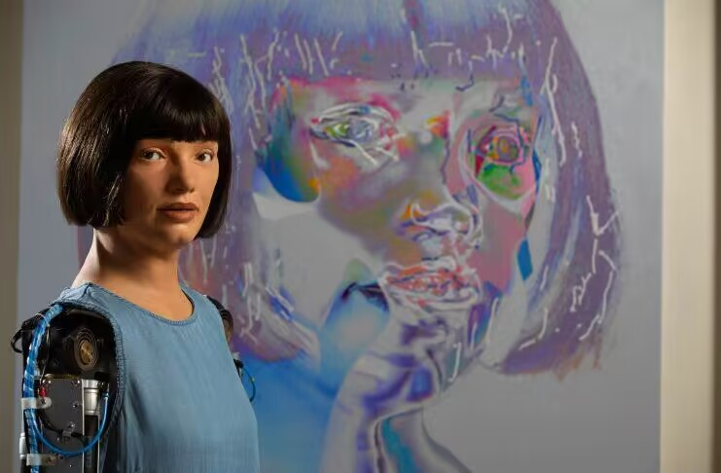
English gallerist Aidan Meller
&
Cornish robotic business Engineered Arts
Boston Dynamics

Slide 7
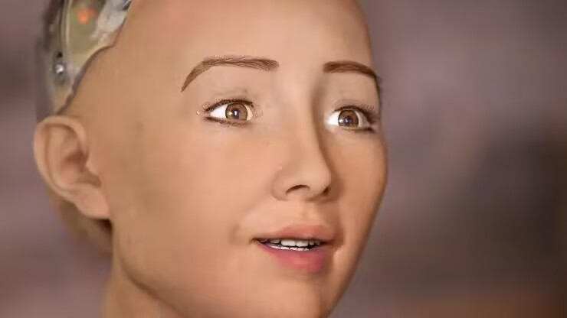
Concerns for the future
Robo-C
- 18 moving parts in its face
- 600 micro facial expressions

Slide 8
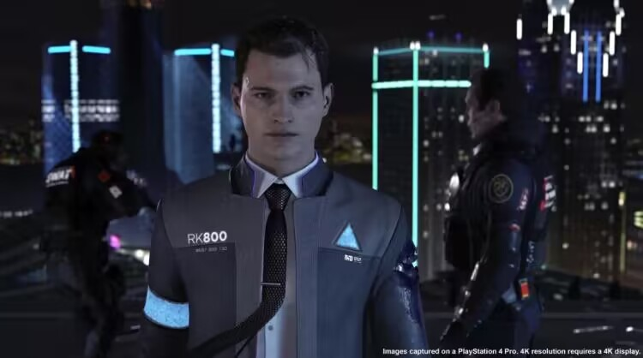
Concerns for the future
- human unemployment was high
- people resentful of the androids
- androids rebel at being servants
another species
vs
biological machines

Slide 9
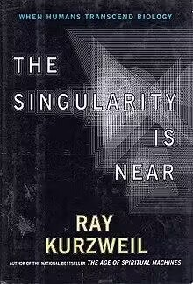
The Singularity Is Near
- by inventor and futurist Ray Kurzweil.

